Slide 1
MANU-CAST® ORGANIC - SERIES

Slide 2
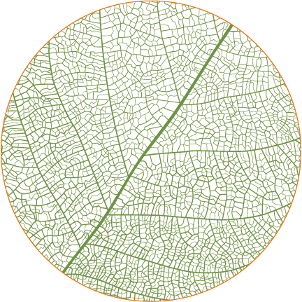
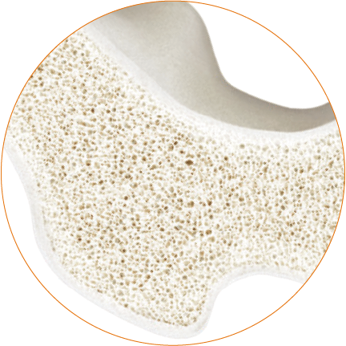
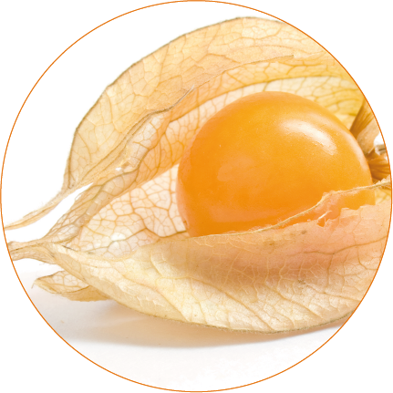
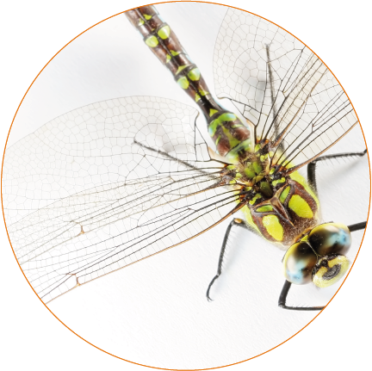
ORGANIC STRUCTURE
INSPIRED BY NATURE
DESIGN
STABILITY
FLEXIBILITY
LIGHTNESS
Nature has its very own language of forms.
It alone creates a clear harmony between
structures, aesthetics and functionality.
Its complex architecture
makes it possible:
The well thought-out construction of natural shapes is extremely stable
and can thus protect against external influences.
The design of organic structures makes amazing things possible.
This is how surfaces adapt
dynamically and thus remain extremely flexible.
Nature can use its resources economically, for more effectiveness. Nature always limits itself
to its bare essentials while remaining efficient.

Slide 3
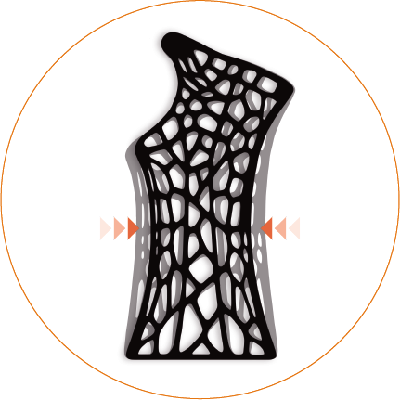
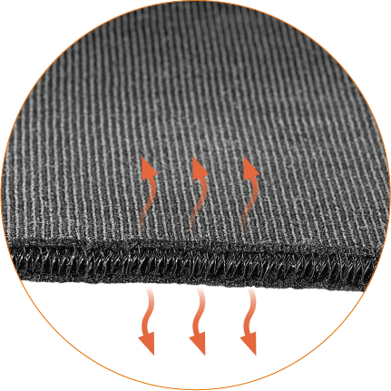
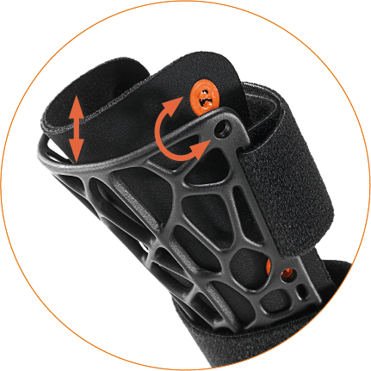
ORGANIC TECHNOLOGY
INSPIRED BY NATURE – CARE FOR NATURE
High breathability and
optimum air circulation
due to the 3D SPACE KNIT frame pad
Granulate from recycled materials
ORGANIC FRAME
Provides optimal fit, relief and stabilisation due to its organic structure
3D SPACE KNIT FRAME PAD
The breathable frame padding supports an optimal fit due to its high adaptability
Optimized use of materials for more lightness - with high stability due to the
the organic structure
QUICK CLICK SYSTEM
Allows easy removal, change and insertion of the 3D SPACE KNIT
Light
Optimal
Fit
Breathable
Recycled
Materials
X-rays
compatible

Slide 4
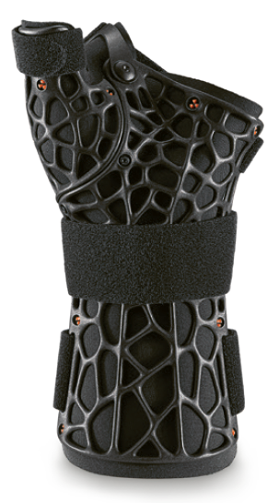
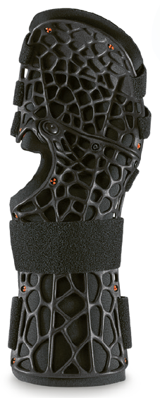
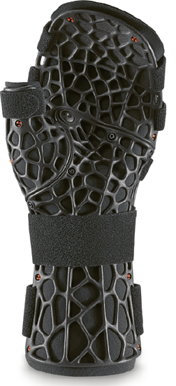
ORGANIC WRIST BRACES
ENGINEERED BY SPORLASTIC
NEW
MANU-CAST® ORGANIC P
Wrist brace with thumb fixation for immobilization
NEW
MANU-CAST® ORGANIC
Wrist braces for immobilization
NEW
MANU-CAST® ORGANIC D
Wrist brace with finger fixation for immobilization
NEW
MANU-CAST® ORGANIC DP
Wrist brace with finger and thumb fixation for immobilization

Slide 5
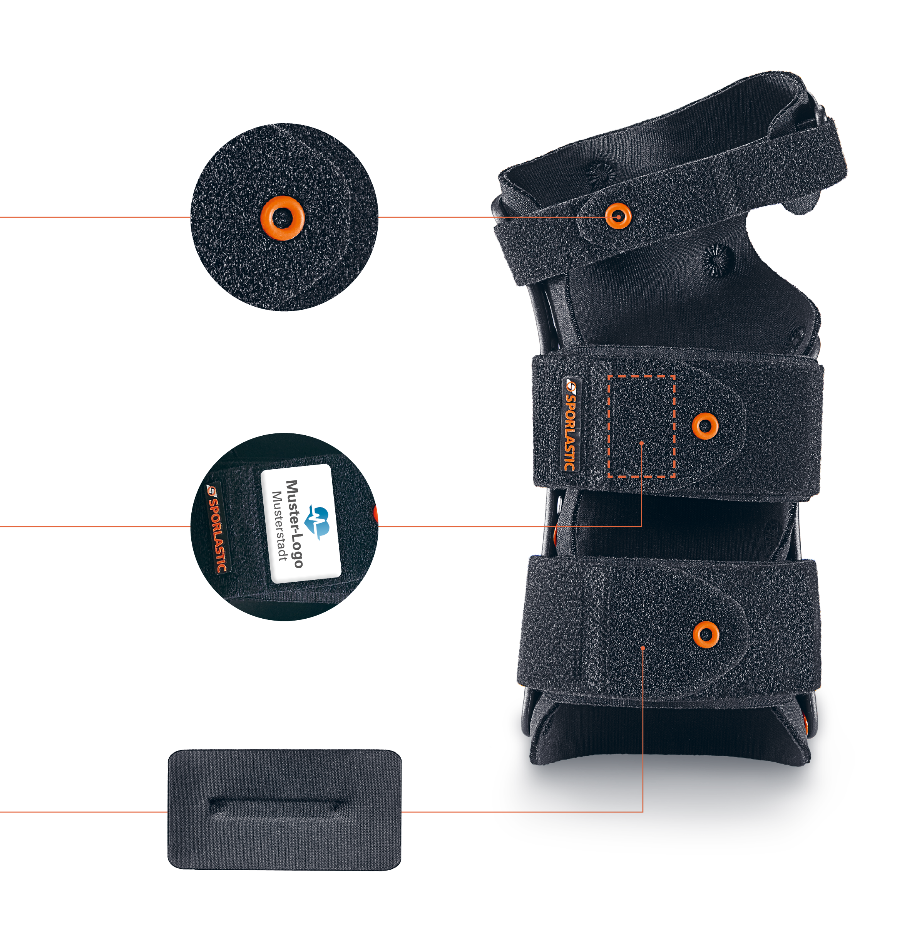
ORGANIC TECHNOLOGY
INSPIRED BY NATURE
Light
Smart handling
thanks to gripping aid and slip stop
Breathable
Washable and removable pads
are easy to clean and therefore hygienic
Customisable
with individual doming
Optimal fit
Few sizes
save storage space and
Simplifies measuring
Recycled materials
Comfortable pads
provide pressure relief
of the straps and adapt to anatomy
X-rays compatible

Slide 6
MORE INFO UNDER
www.sporlastic.de/organic-kontakt

